Slide 1
AGI of Chapel Hill
File created on: 10/6/2019 12:39:48 AM

Slide 2


Slide 3


Slide 4


Slide 5


Slide 6


Slide 7


Slide 8


Slide 9
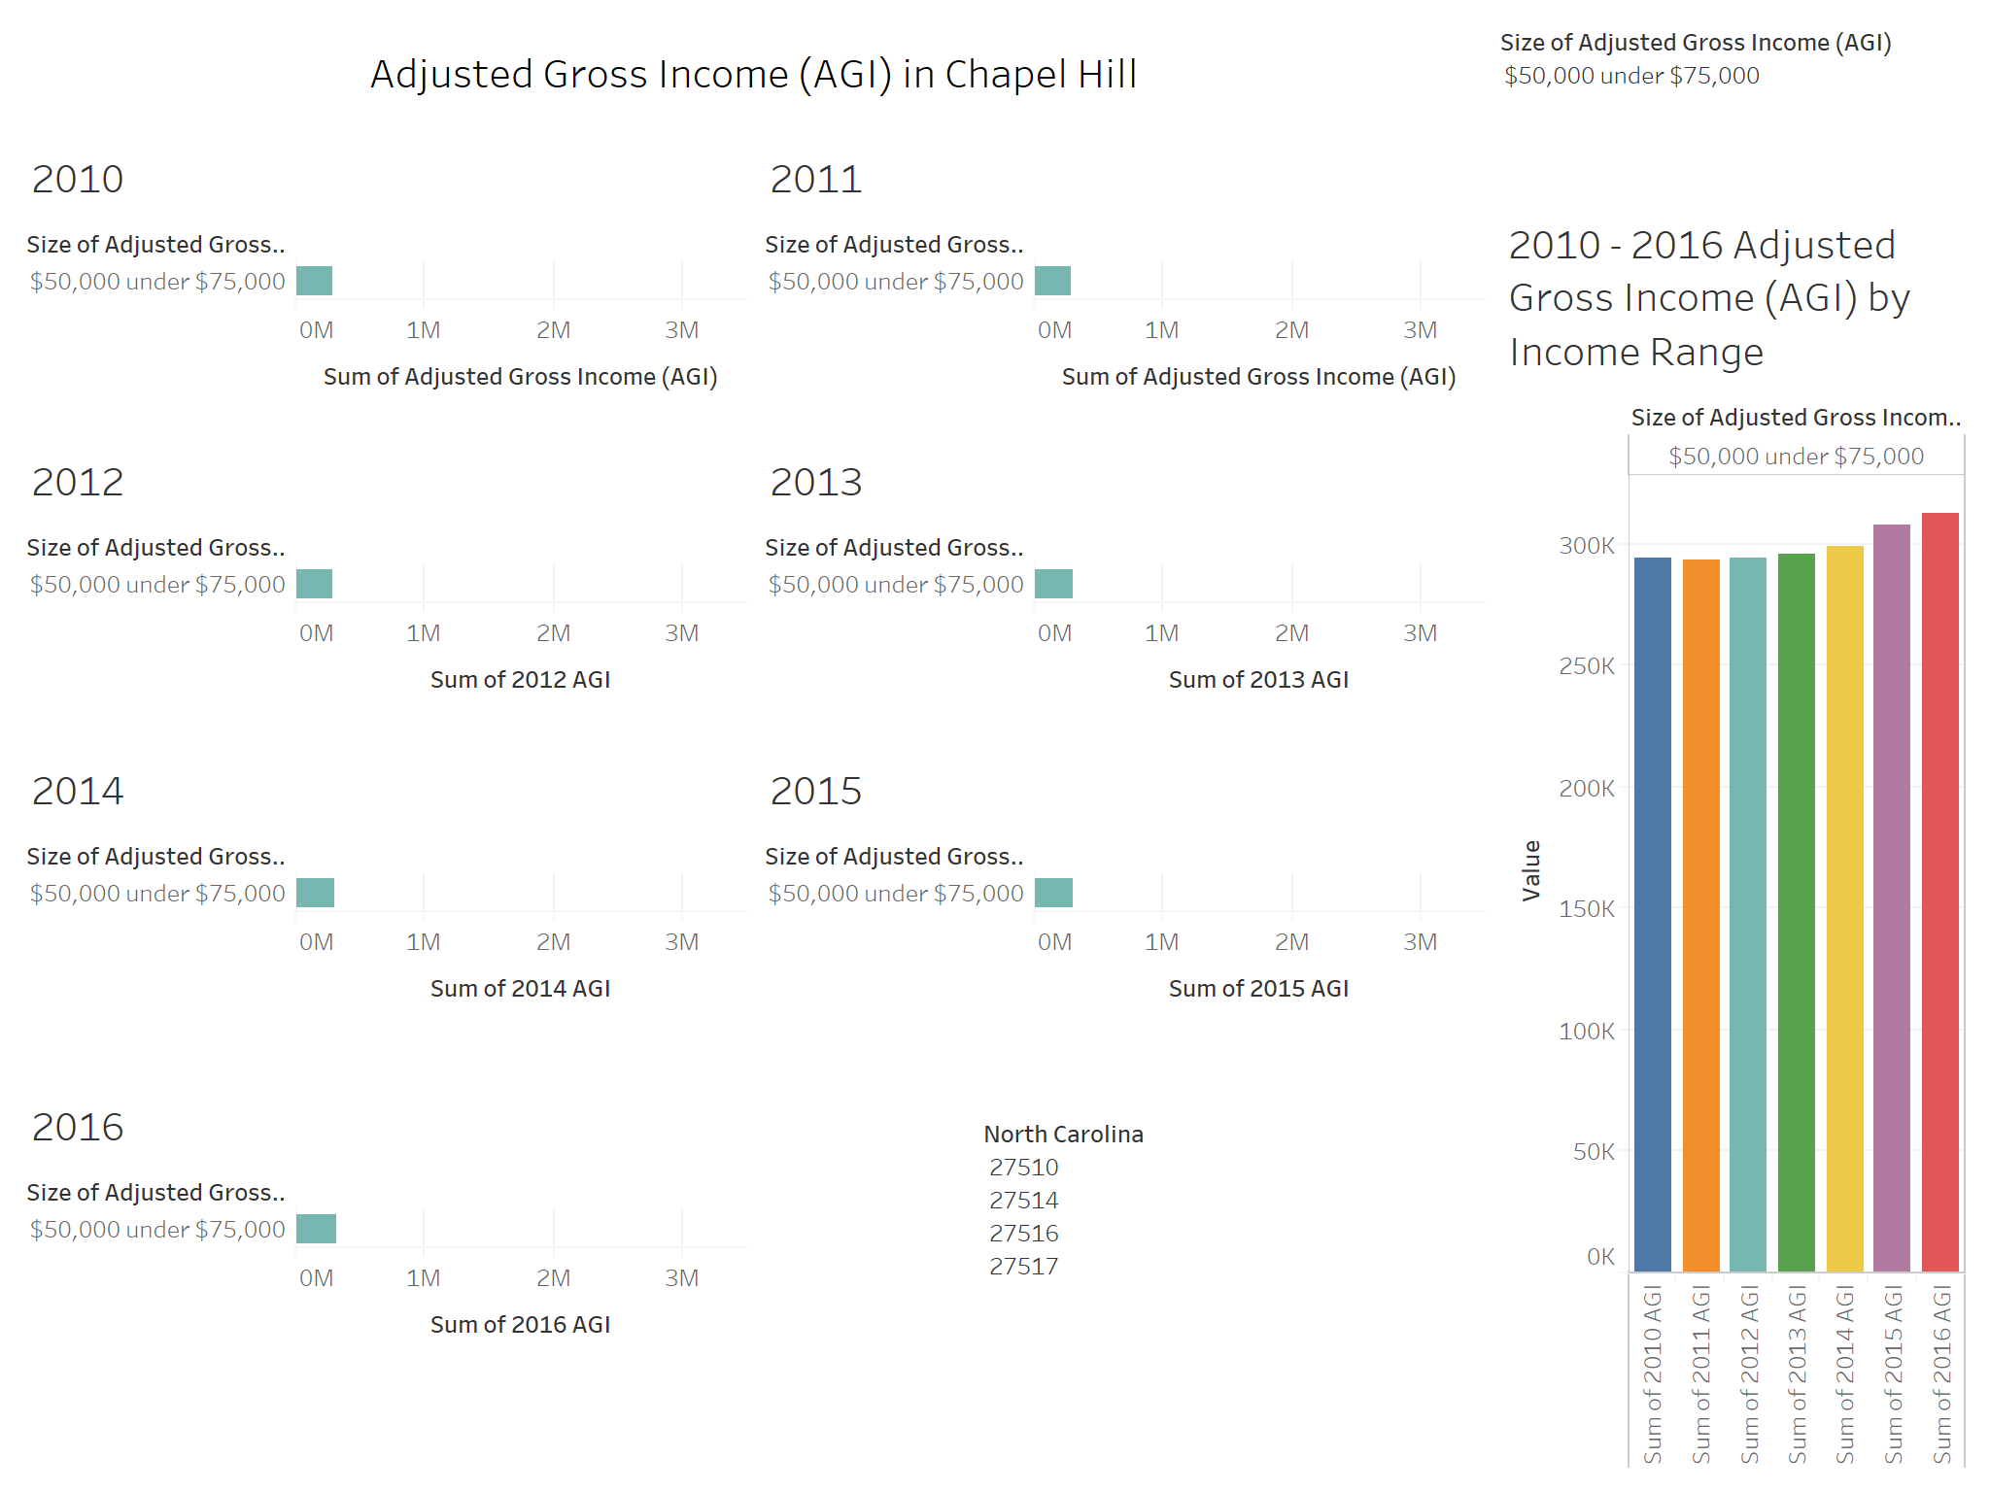

Slide 10


Slide 11
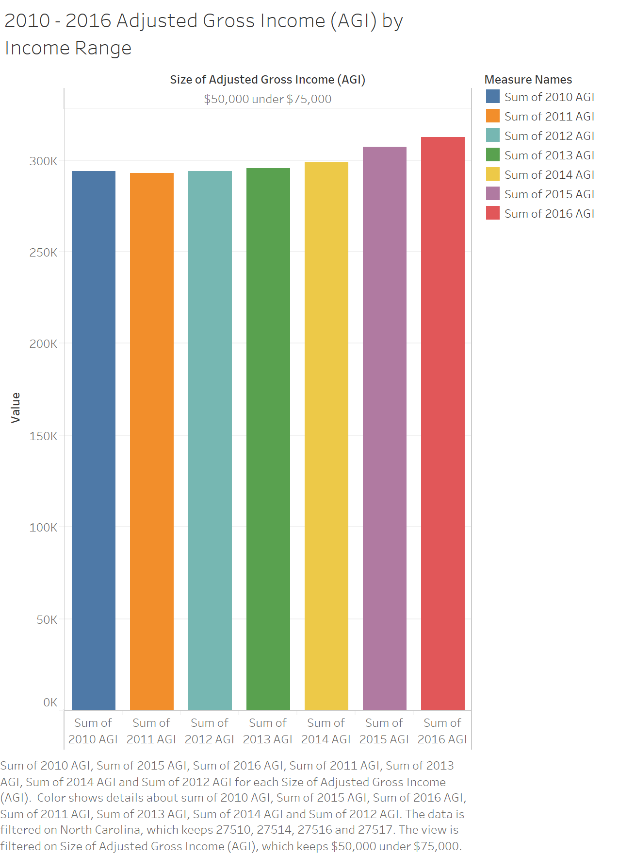

Slide 12
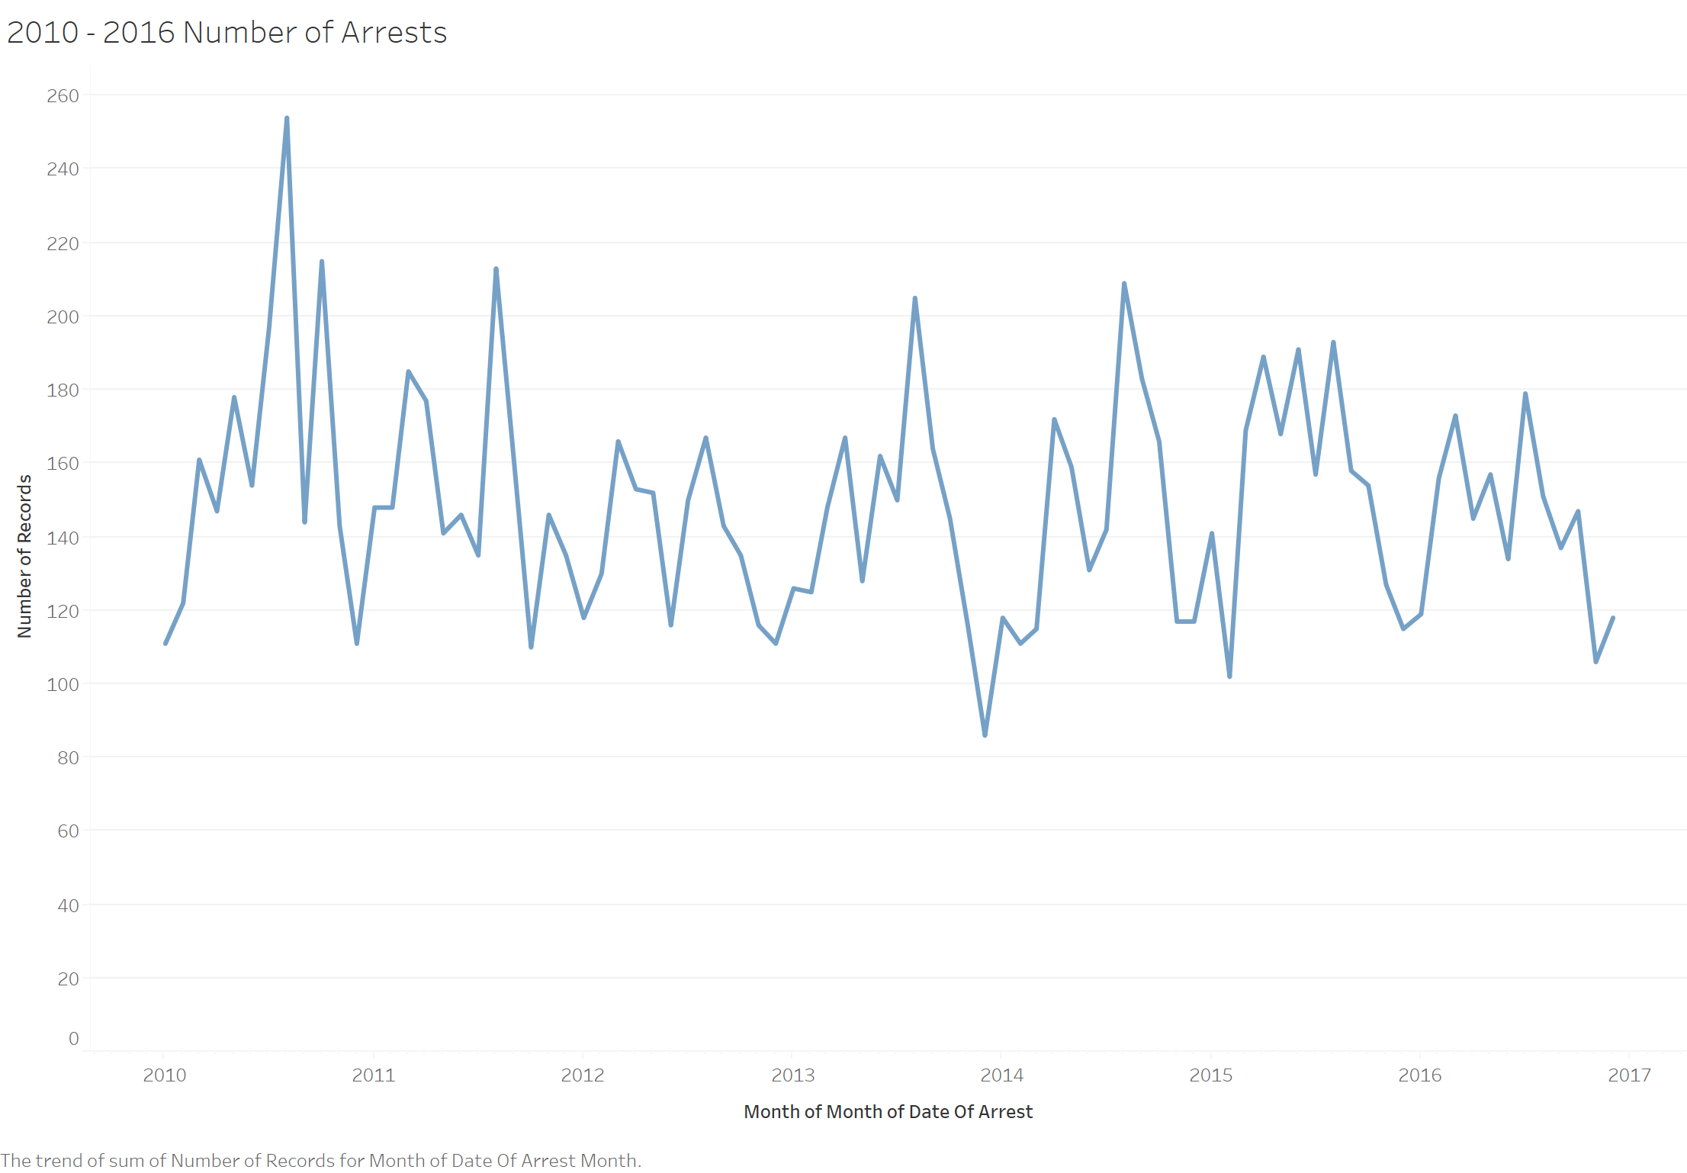

Slide 13
